Slide 1
Recognizing Audio Data with a FPGA
Using Neural Networks
Julian Hatzky - 14.06.2019 - TH Köln, im Rahmen des Eingebettete Systeme Praktikums
Faukltät 07

Slide 2
Overview
About the project
Initially identified problems
Project timeline
Milestone Review
Milestone 1 : Augmented Audio Samples
Milestone 2 : Evaluation of Frameworks
Milestone 3 : Trained Neural Network ( Proof of Concept)
Milestone 4 : Using Audio Data on the FPGA
Milestone 5 : Implementation of Neural Network on the FPGA
Problem statement
Timetable
Questions

Slide 3
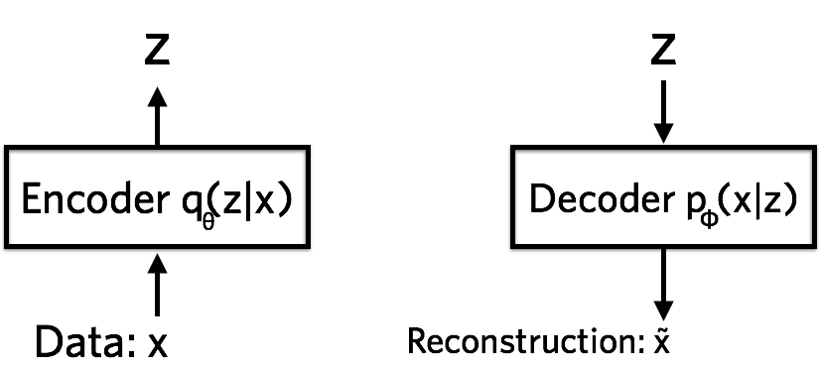
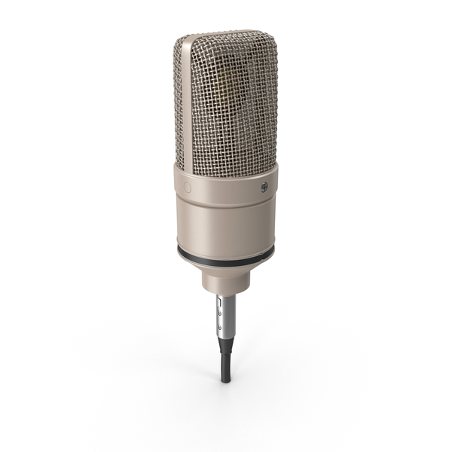
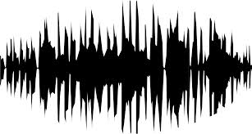
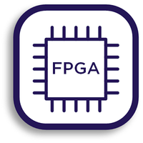


About the project
Is this the learned Audio Signal ?
Use a Neural Network implemented on a FPGA to detect a specific Audio Signal.

Slide 4
What are the main problems and possible solutions?
Only a few Audio Samples
Data augmentation
Choosing of a Framework
Evaluation of Pytorch and Keras/Tensorflow as possible candidates
Using the appropriate Neural Network/ Machine Learning Algorithm
Try different algorithms on the Data and see what fits the best (computer)
Storing/Using the Audio Data on the FPGA
USB interface and FIFO buffer
Describing a Neural Network in VHDL
Implementing a small architecture with only a few Neurons for a proof of concept

Slide 5


Project timeline
MS1
Augmented Audio Samples
MS3
Trained Neural Network
MS5
Neural Network PoC on FPGA
MS5.5
Complete Neural Network implementation on FPGA
26.04.2019
17.05.2019
19.04.2019
10.05.2019
31.05.2019
Testing and specification
MS2
Evaluation of Frameworks
MS4
Usage of Audio Data on FPGA
MS6
Zwischenbericht:
14.06.2019
Fertiggestellte Teilaufgaben
MS7
Abschlusspräsentation:
12.07.2019
Vollständiger Bericht
Kick-off:
12.04.2019
Projektvorstellung

Slide 6
Milestone 1 : Data Augmentation
Given: 5 Audio Samples ( 3 of them actually usable)
The idea: Use different augmentation methods (e.g. shifting, noise, stretching) to generate more data
Result: more than 300 samples of audio data (even more possible)

Slide 7
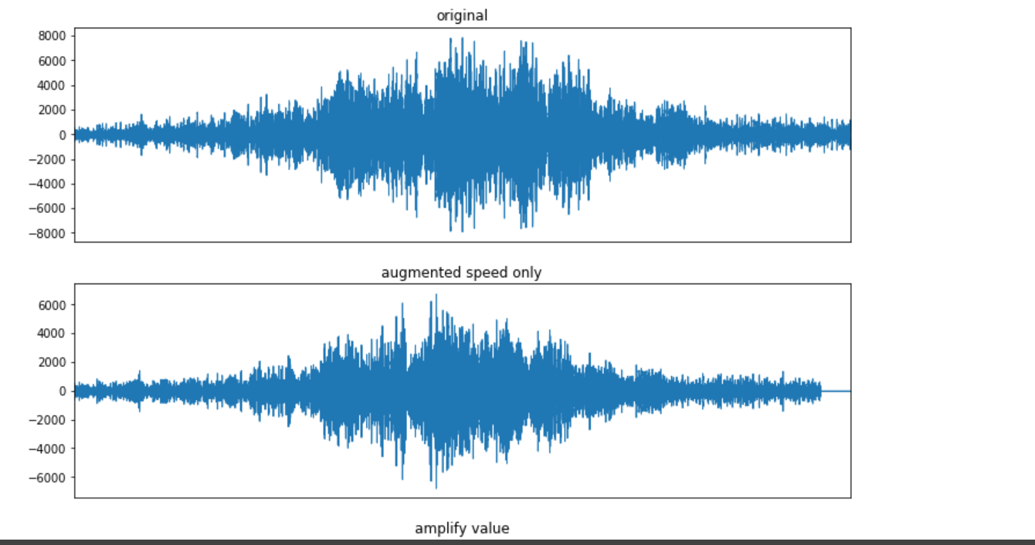
Demo

Slide 8
Milestone 2: Evaluation of Frameworks
Which Framework is a feasible to implement the Neural Network?
→ Spoiler: Tensorflow 2.0 (even though in alpha version)

Slide 9
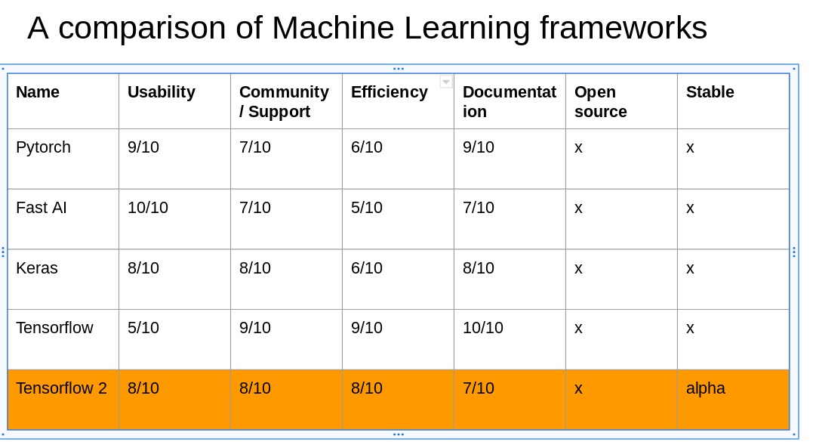

Slide 10
Milestone 3: Trained Neural Network
The idea:
Use a denoising autoencoder to figure out a latent representation of the Auto Encoder.
→ What are the main indicators for the specific Audio Signals + noise is getting filtered
Use a classifier to determine how likely the audio signal is “our one”.

Slide 11
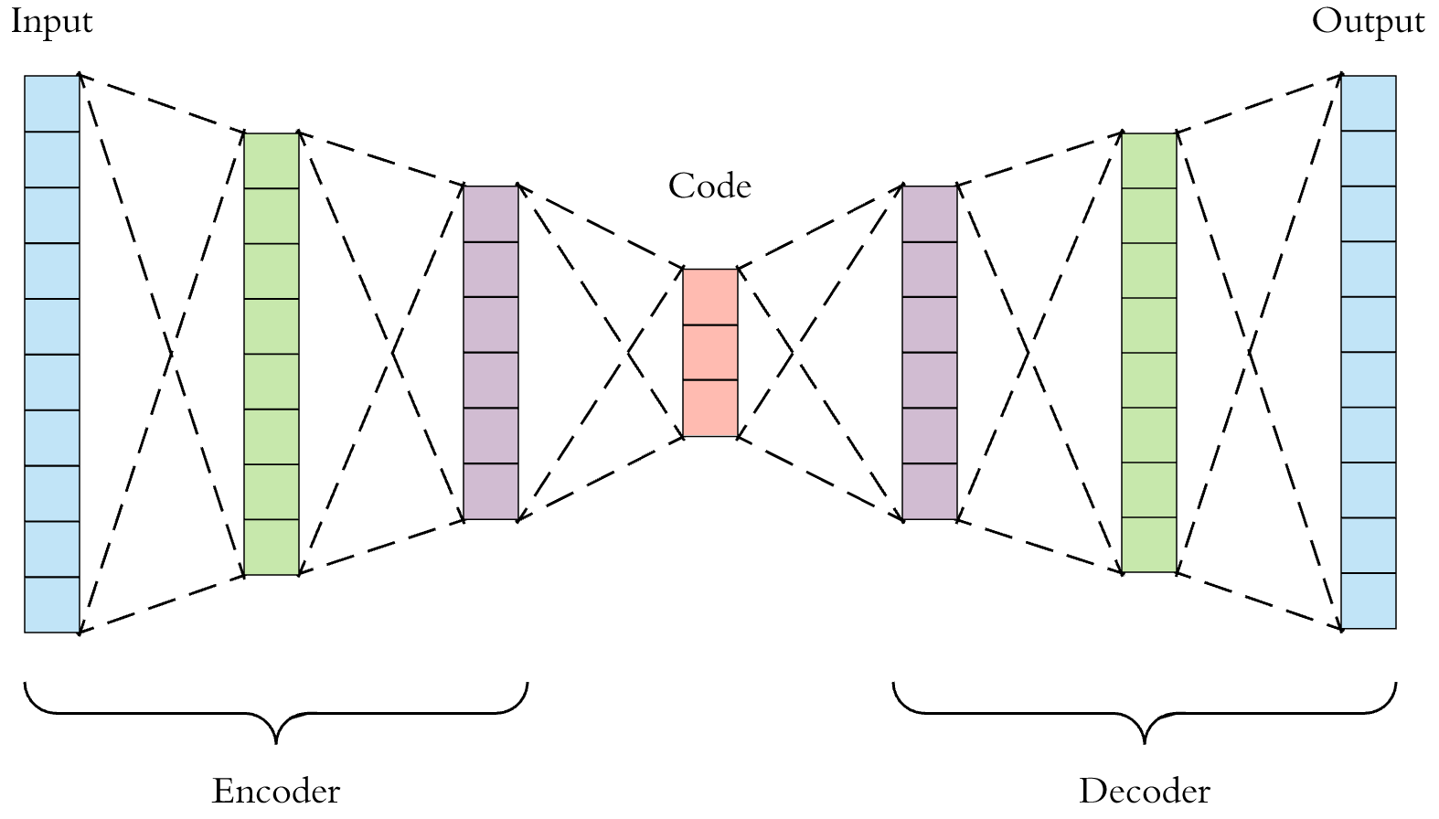
Deep AutoEncoder (Unsupervised Learning)

Slide 12
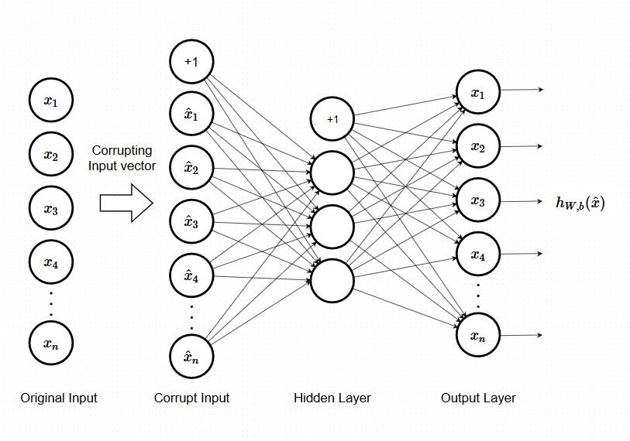
Denoising Autoencoder (better generalization)

Slide 13
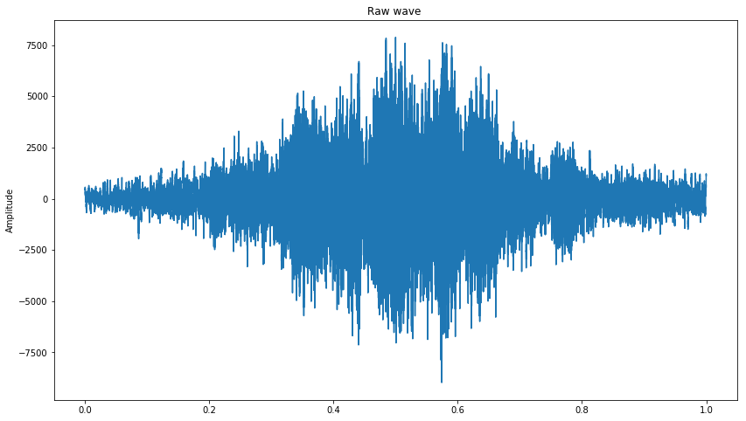
Denoising Autoencoder
Works !
But could be better !
→ Adjustments needed
Proposals:
Test with different dimensions, noise functions, input data.
More training! (gpu + data)

Slide 14
Milestone 4: Using Audio Data on the FPGA
How to process audio data ?
Using the Altera DE2 Board (FPGA)

Slide 15
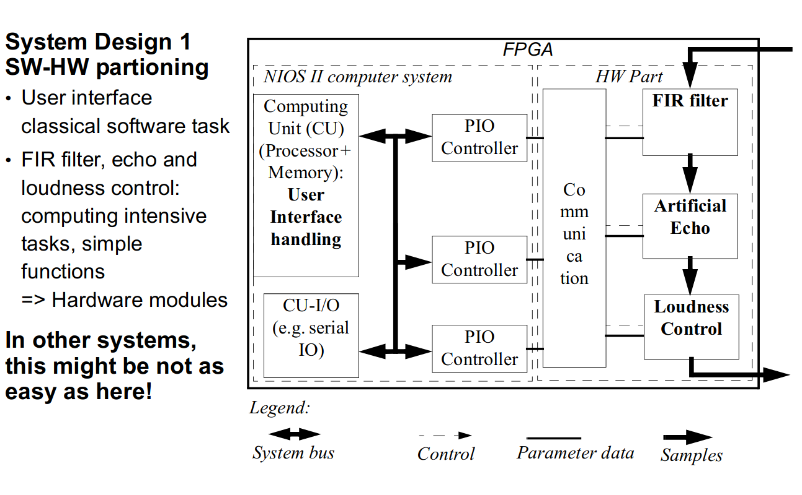
The proposed architecture (DS SoC Lab 1: HW Part)

Slide 16
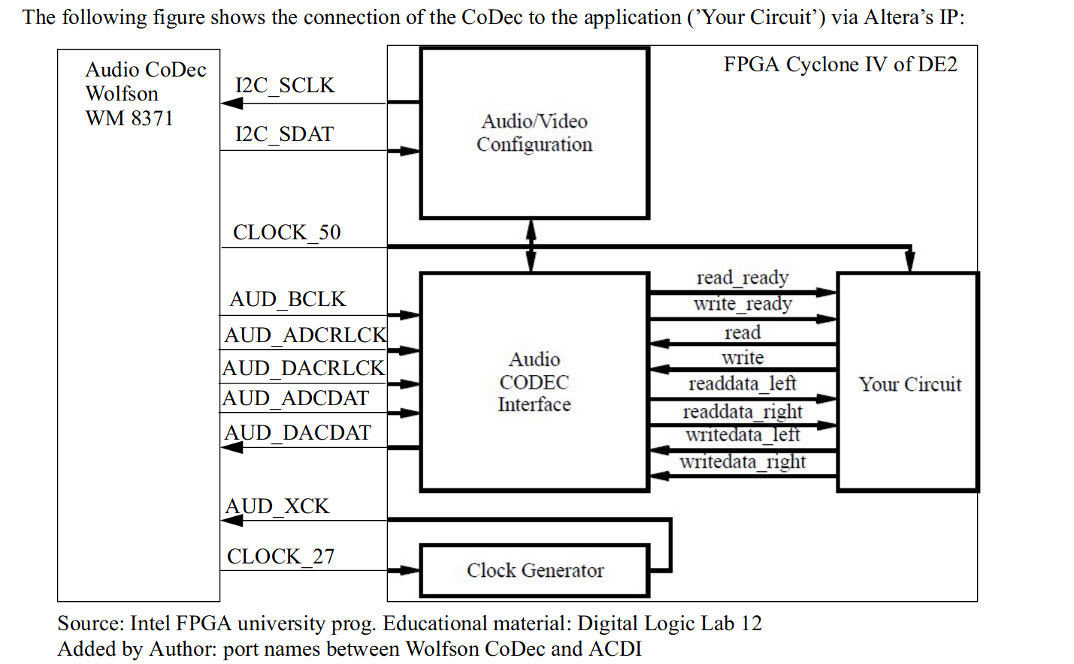
The HW part audio processing (DS Soc Lab 1)

Slide 17
The Idea
Change the FIR Filter with a denoising variational autoencoder ( deep neural network)
Denoising Autoencoder

Slide 18
But first…
How to actually process the Audio Data?
Wolfson Audio Encoder / Decoder
Altera/LAB IP cores
“Your circuit” :
State machine + buffer register

Slide 19
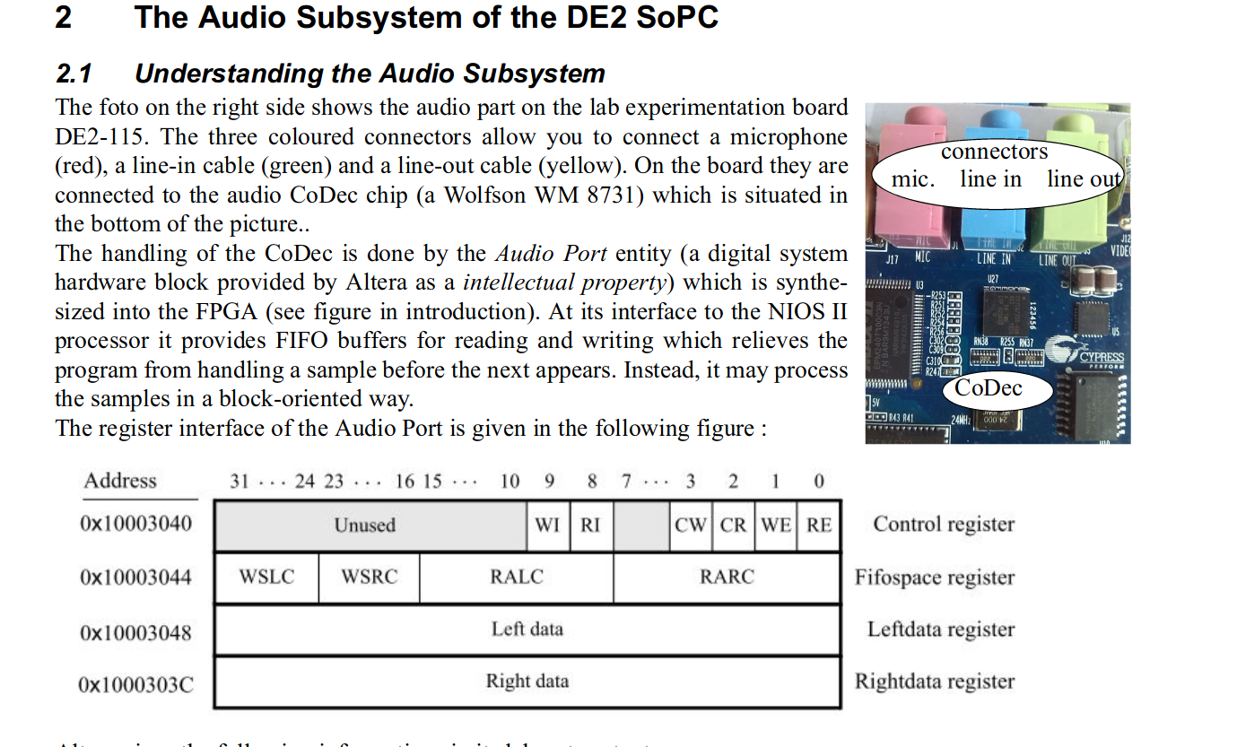

Slide 20
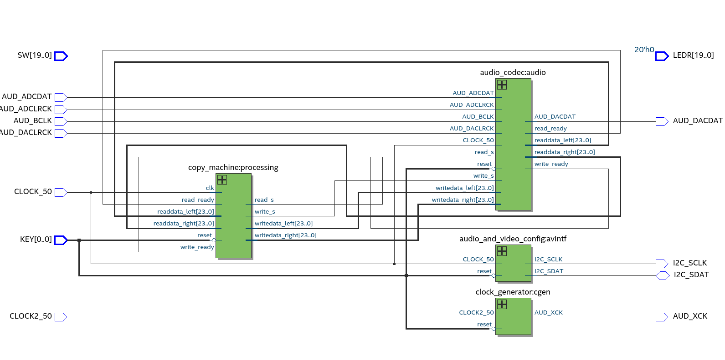
The architecture ( RTL Viewer )

Slide 21
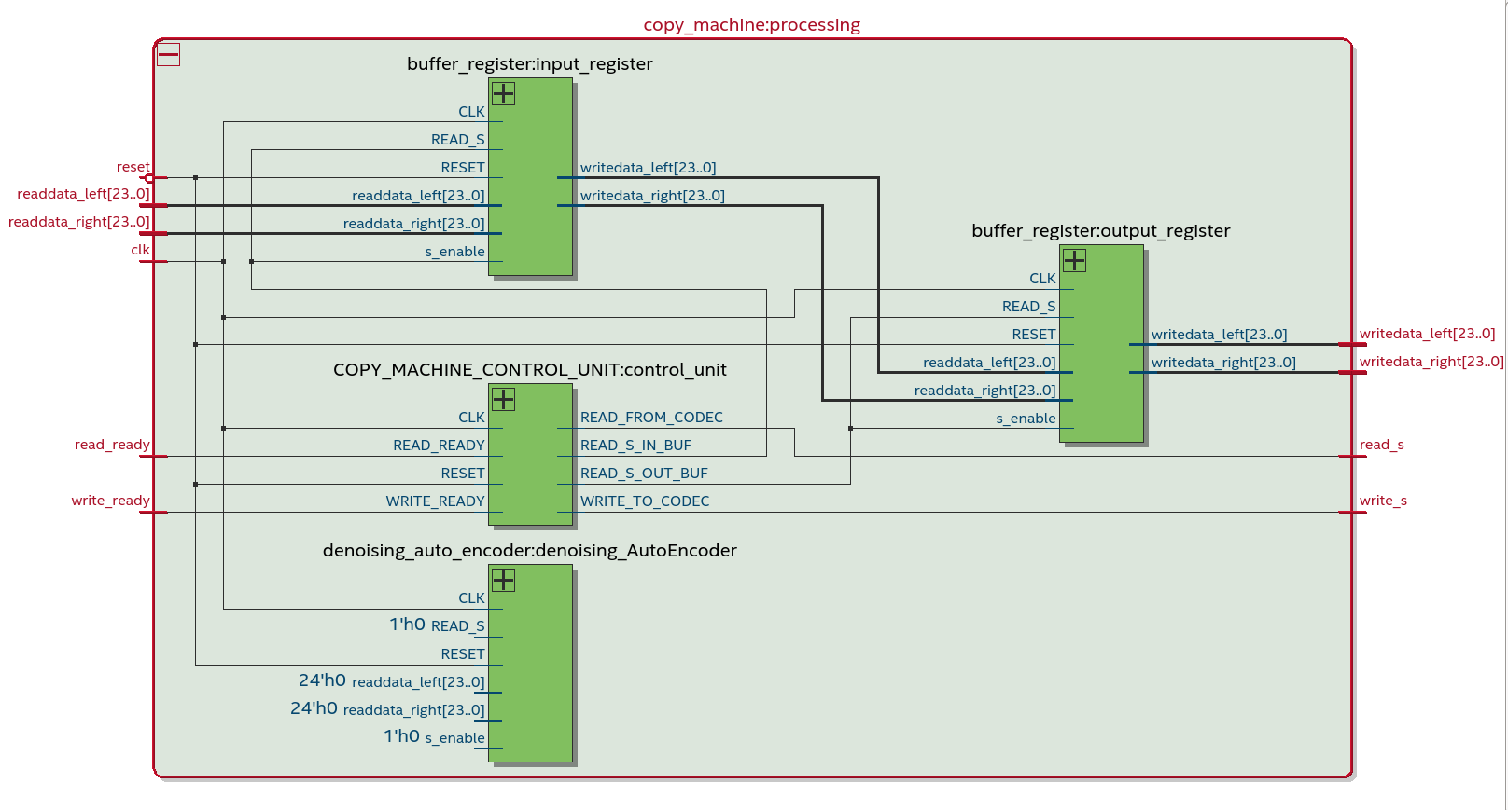
Copy Machine (RTL View)

Slide 22
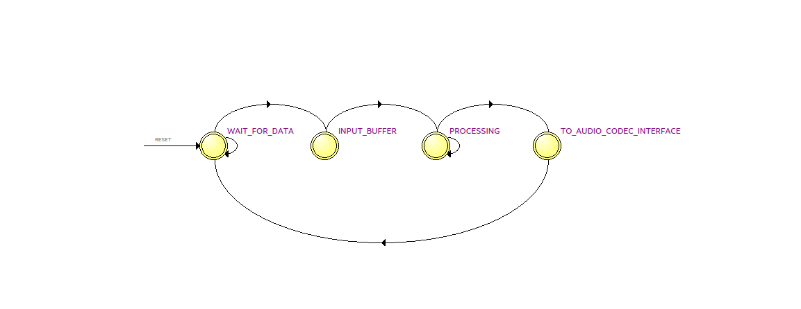
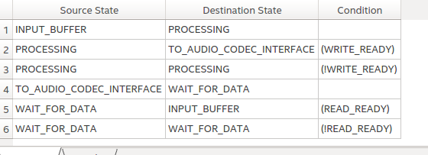
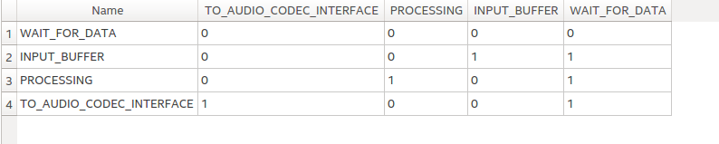
Copy Machine Control Unit (State Machine Viewer)

Slide 23
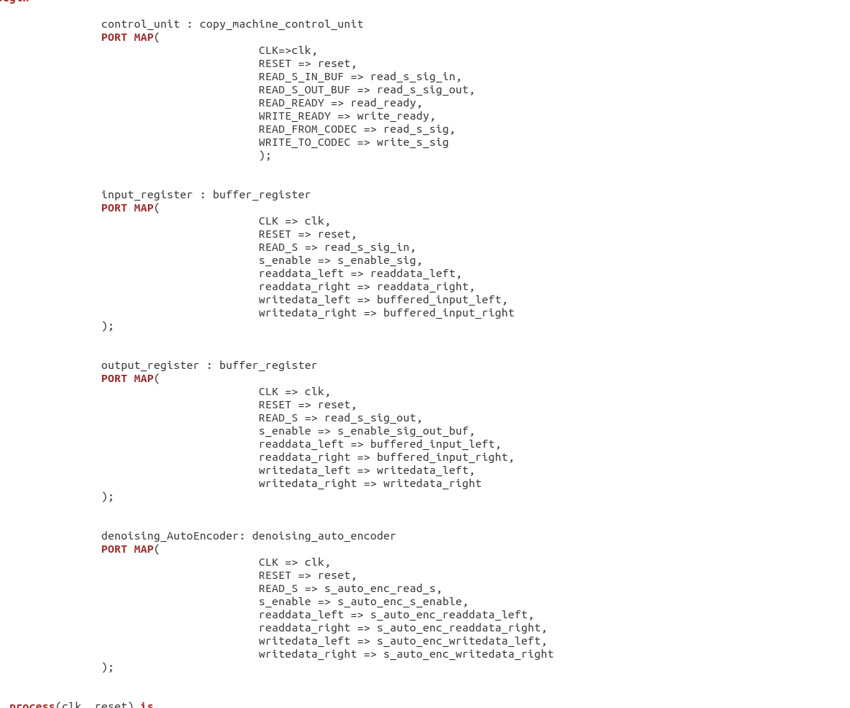
Copy Machine VHDL snippet

Slide 24
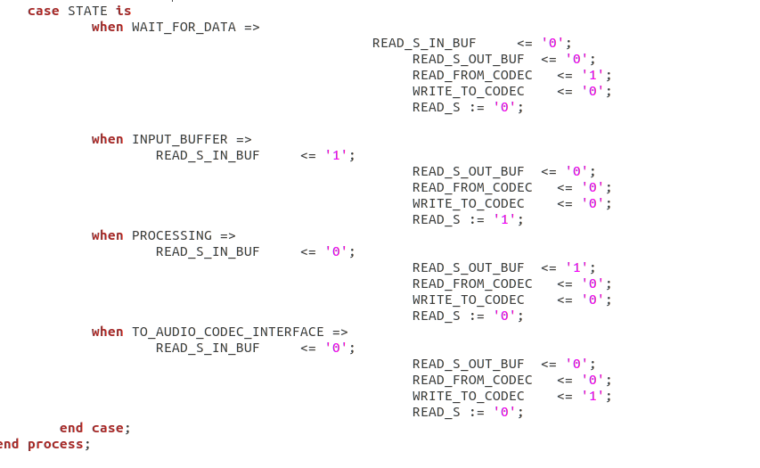
Control Unit VHDL snippet

Slide 25
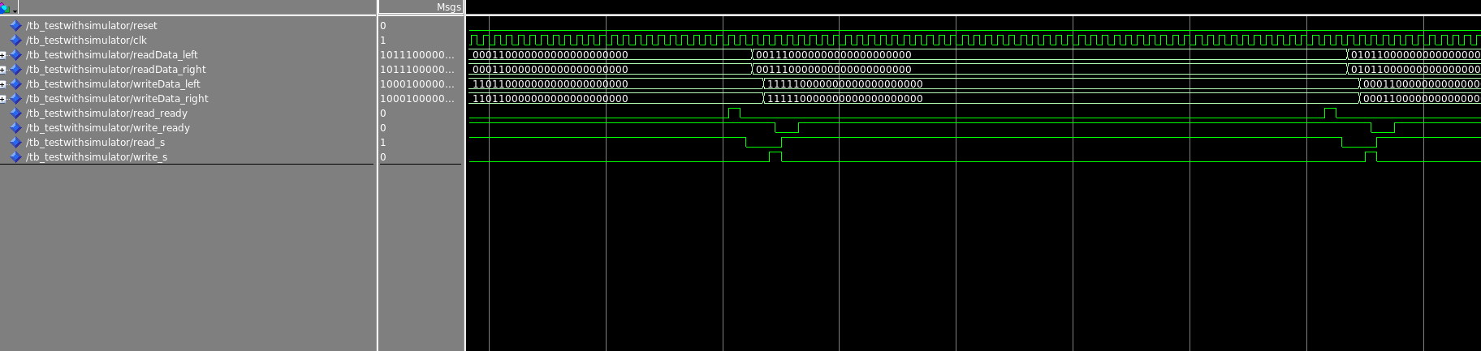
Simulation (Modelsim): Testbench Audio Processing

Slide 26
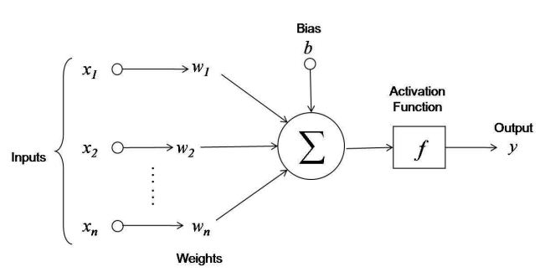
Milestone 4_5 : Neural Network implementation on FPGA
The idea: After the Auto Encoder is optimized in reconstructing the Audio signal back from its latent representation and to filter out noise the idea is to extract each Neuron (function and weights) and implement it in VHDL .

Slide 27
But what about exponential functions?
There are a lot of different approaches out there.
A possible solution is, for example, the expansion as Taylor series. The implementation as you can understand could be very demanding in terms of operation.
Another one is lookup table. Feasible for fixed size (not highly scaled/densed) Neural Network.

Slide 28
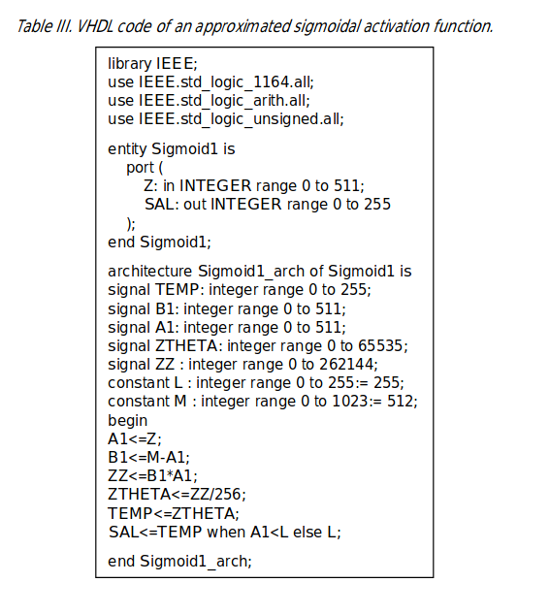
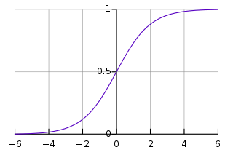
Exponential functions and LUTs
Example for an Sigmoidal activation function.
“Journal of Applied Research and Technology “

Slide 29
Classifier
The idea: Use the training data to ...
1. Adjust the weights for the denoising autoencoder
2. Create an “optimal” vectorized representation of the autoencoder
(3. Create an “optimal” latent vector of the audio signal).
Now when feeding in another audio signal:
Take the output vector and calculate the squared euclidean distance between it and the one created in 2. The same can be done with the latent vector created in 3. Define a threshold / distance within the audio sample is defined as correct / or not .

Slide 30
Problem statement
How to advance the quality of the Auto Encoder
Determine how to actually feed in Audio Data in the FPGA is still a “big thing” . When to start / stop sampling etc.
Driver / JTAG issues with Ubuntu and Quartus
How to determine the quality of the implementation ? (Validation) -
HOW TO DEBUG ? Example Idea: forward the recreated audio signal and listen to it
How to extract the important neuron information and how to translate them into VHDL ?

Slide 31
Timetable
Deadline: 5.7.2019
~3 Weeks left.
Tasks to tackle: Focus on the AutoEncoder VHDL part and “on-board” processing.
Improvement of the quality of documentation.

Slide 32
Questions ?
THANK YOU !

